Slide 1


Video jocs: Introducció
Vicent Selfa
Curs 2020/2021
Notes:
‹#›

Slide 2
Índex:
Un bon moment per als videojocs
Els problemes … Les solucions ...
Un motor de videojocs?
Diferents aspectes dels motors de videojocs
Per què Unity?
Unity
Conceptes
Elements bàsics
Programació amb Unity
Notes:
‹#›

Slide 3


Un bon moment per als videojocs
El mercat dels videojocs es troba en un dels seus millors moments.
2.300 milions (*) de jugadors de tot el món gastaran 137.900 milions de dòlars en jocs el 2018. Això representa un augment del + 13,3% respecte a l'any anterior, o 16.200 milions de dòlars. Els ingressos dels jocs digitals ocuparan el 91% del mercat mundial amb 125.300 milions de dòlars.
Els jocs per a mòbils continuaran sent el segment més gran després de 10 anys de creixement de dos dígits des que es va llançar el primer iPhone el 2007.
En total, els ingressos per mòbil creixeran un + 25,5% interanual fins arribar als 70.300 milions de dòlars. Això significa que per primera vegada, més de la meitat de tots els ingressos del joc provindran del segment de mòbils.
Els telèfons intel·ligents representaran el 80% d’aquest import, o 56.400 milions de dòlars, i el 20% restant provindrà de tauletes. El joc de consola és el segon segment més gran que genera 34.600 milions de dòlars el 2018, mentre que els jocs de PC aportaran 32.900 milions de dòlars.
(*)
Més informació ací
^{(*) 2.300.000.000}
Notes:
‹#›

Slide 4

Un bon moment per als videojocs
(*)
Notes:
‹#›

Slide 5


Un bon moment per als videojocs
Notes:
‹#›

Slide 6

Un bon moment per als videojocs
"En el transcurs d'una dècada, els jocs per a mòbils hauran passat del segment més petit el 2012 a una indústria de 100.000 milions de dòlars el 2021".
Notes:
‹#›

Slide 7
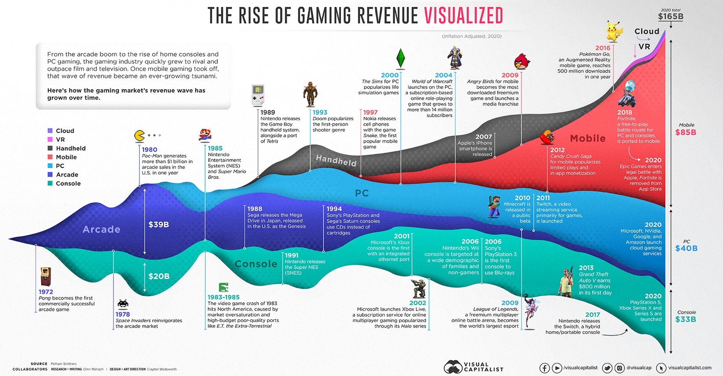
Un bon moment per als videojocs
Més informació ací
Notes:
‹#›

Slide 8
Els problemes
Hi ha moltes plataformes
Escriptori (Windows, Mac, Linux)
Web (Facebook, Chrome, WebGL, etc.)
Plataformes mòbils
Android
iOS
Consoles
Wii / Xbox / PS4 / PS Vita
Nintendo DS, Switch ...
Aquests aspectes compliquen molt el desenvolupament del joc.
Notes:
‹#›

Slide 9

Les solucions ... Un motor de videojocs?
Els marcs com LibGDX resolen un aspecte que ens permet desplegar diverses plataformes i fer el desenvolupament una mica més àgil, però, n’hi ha prou?
La indústria dels videojocs és competitiva i requereix prototipatge i un desenvolupament ràpid.
Els motors de videojocs com Unity permeten fer prototips molt ràpids i la seva corba d’aprenentatge és curta.
Notes:
‹#›

Slide 10


Diferents aspectes dels motors de videojocs
Positius:
Disminuir la complexitat del desenvolupament
Multiplataforma
Reducció dels temps de desenvolupament → menys costos.
Negatius:
Dependència
No arribar als autèntics límits d’un dispositiu concret.
Dificultat amb característiques no implementades.
En alguns casos, cost elevat.
Avantatges i desavantatges de les principals eines de desenvolupament de jocs (2017)
Notes:
‹#›

Slide 11
Requisits del motor de videojocs
Un potent editor d’escenes 2D i 3D, importació de recursos en diferents formats, editor de scripts, animacions 2D i 3D, GUI, previsualització ràpida, gestió d’entrades, gestió de so, etc.
Motor de scripting eficient.
Motor físic i renderització avançada.
Distribució multiplataforma simple.
Altres: editor multiplataforma, sistemes de partícules, edició terrestre, LOD (nivell de detall), control de versions, connectors, extensió de l’entorn mitjançant scripts, documentació completa, ecosistema de tercers (complements de tercers), cost no elevat.
Notes:
‹#›

Slide 12









Diferents motors de videojocs
Notes:
‹#›

Slide 13
Per què Unity?
Perquè compleix molts dels requisits anteriors.
Versió bàsica gratuïta (Personal Edition) per generar jocs multiplataforma (Windows / Mac / Linux / WebGL / iOS / Android / WP / BlackBerry i consoles principals).
Editor disponible per a Windows i Mac.
Un entorn de desenvolupament potent basat en Mono Project, que admet els llenguatges C # i Javascript (utilitzarem C # per a la seva potència).
El motor amb més usuaris i jocs del moment.
Asset Store que ofereix un gran ecosistema de complements.
Àmplia documentació i un gran nombre d’exemples.
Títols importants del mercat: https://unity.com/madewith
Unity user manual
Notes:
‹#›

Slide 14


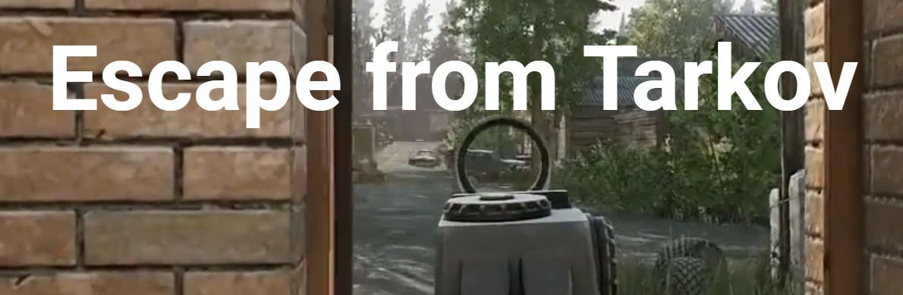
Per què Unity?
Made with Unity
Notes:
‹#›

Slide 15

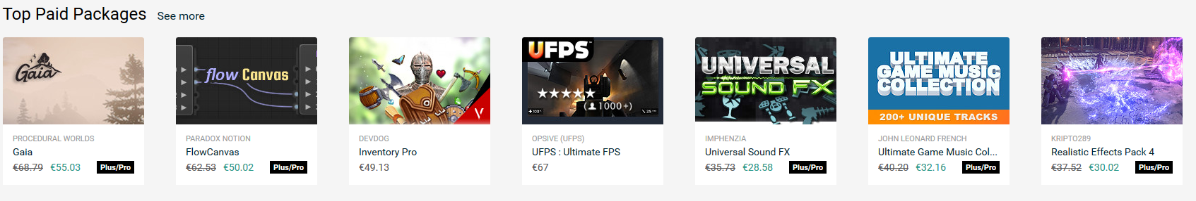
Unity Asset Store
La Unity Asset Store alberga una biblioteca creixent d’actius comercials i gratuïts creats tant per Unity Technologies com per membres de la comunitat. ... S'accedeix als recursos des d'una senzilla interfície integrada a Unity Editor i es descarrega i s'importa directament al vostre projecte.
What’s the Unity Asset Store?
The Unity Asset Store
Notes:
‹#›

Slide 16
Unity:
Introduction
Notes:
‹#›

Slide 17

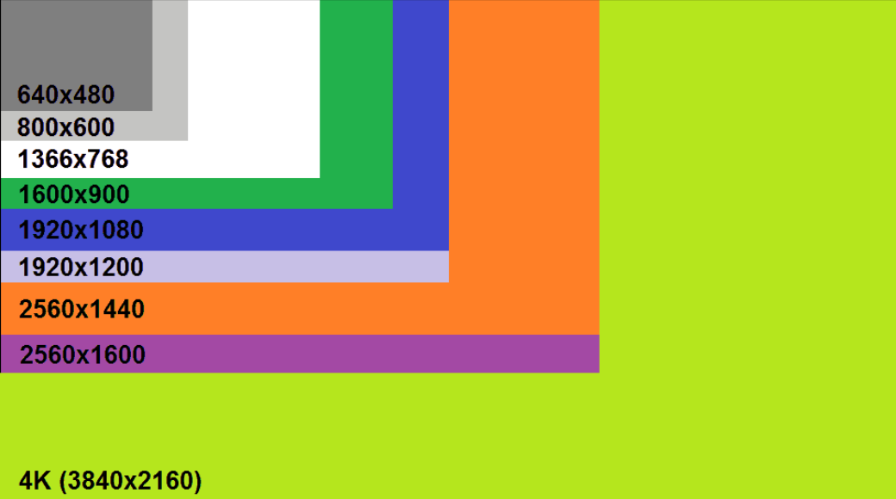
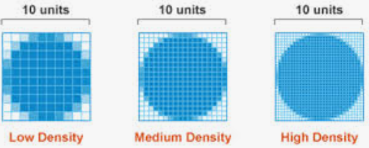
Basic concepts (I)
Pixel: The smallest unit that we can represent in a screen. Each pixel has a position and a color. The images that are represented on a screen are formed by millions of pixels
Screen resolution: determines the number of pixels that can represent a screen, and in turn, the number of divisions horizontal and vertical that it has. Example: 1920 x 1080 pixels
Pixel density: measured in ppi (pixels per inch) determines the number of pixels that a screen has per inch. It depends of the physical dimensions of the screen and the resolution.
Pixel
Screen resolution
Pixel density
Notes:
‹#›

Slide 18
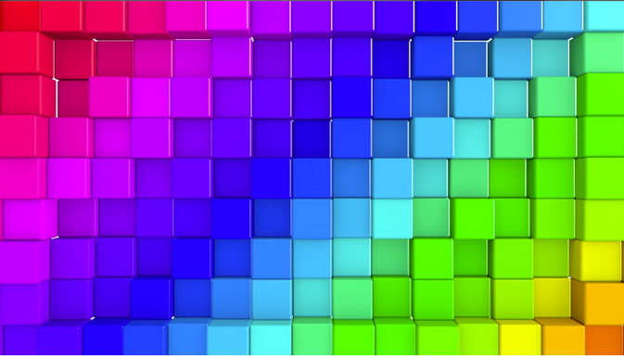

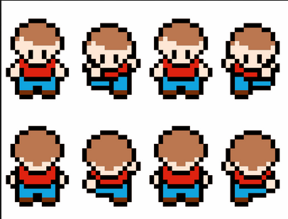
Basic concepts (II)
Depth of color: Number of bits that are destined to represent the color of each pixel. The greater the number of bits, more colors can be represented. For example, with 16 bits can be represented 2¹⁶ colors, that is, 65536.
Sprite: Image represented in a bitmap with a width and height, usually determined for using with 2D video games to represent the characters and their animations
Sprite sheet: Bitmap that contains all the images that will be used in the game, or on a screen to reduce memory and times of rendering
Depth of color
Sprite
Sprite sheet
Notes:
‹#›

Slide 19

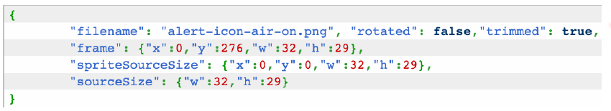
Basic concepts (III)
Animation of sprites: Sequence of images that are drawn quickly to give the feeling of movement. Sprite sheets or Texture atlas are usually used to save the images that make up the animation.
Texture atlas: Very similar to the sprite sheet since the two group all the sprites into one image, but the atlas also has another file, usually in json format, which indicates the positions (x, y), the height and width of each sprite, so it's much easier to access to each sprite individually.
Notes:
‹#›

Slide 20
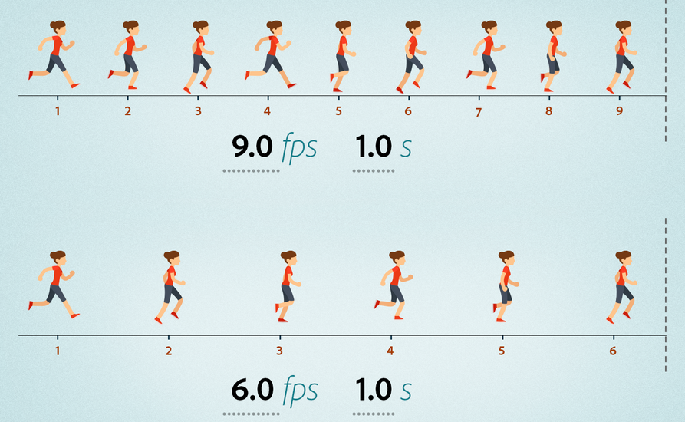
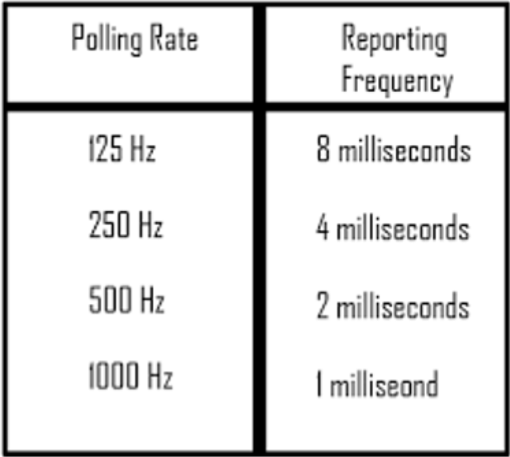
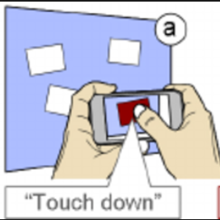
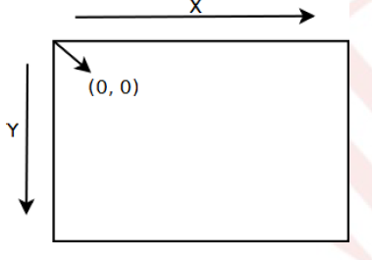
Basic concepts (IV)
Frame rate: Number of times that the main loop of the game runs per second. It is also often said as the number of times the game screen is drawn per second. It is measured in FPS (frames per second).
User input management: it can be done in two ways:
Polling: periodic query of a value, usually a hardware device or sensor.
Event handling: allows to manage the entry through events (touchDown, touchDragged, TouchUp, etc.)
Coordinate system: All surfaces of the apis graphs must have a system of coordinates. Depending on the api used it will have its origin in one place or another.
Notes:
‹#›

Slide 21
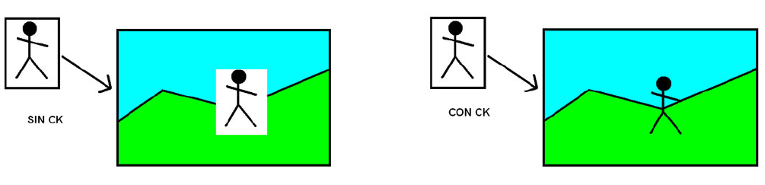
Basic concepts (V)
Rectangular surfaces: All the images that we represent on the screen have rectangular shape, although do not look like it. When you want to simulate different forms use transparencies through techniques such as color keys (CK) and alpha channel (AC).
Color keys: Technique that consists in defining a certain color of the image as transparent.
Without CK
With CK
Notes:
‹#›

Slide 22
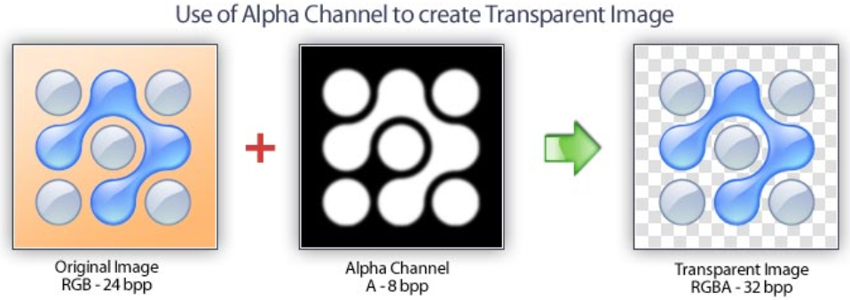
Basic concepts (VI)
Alpha channel: Some image formats, such as png and gif, admit to add a channel to indicate the degree of transparency of the image. With the channel alpha we can achieve the same result as with the Color Keys and we can also make "objects“ semitransparent.
Notes:
‹#›

Slide 23
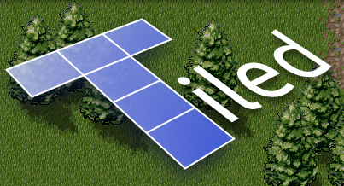
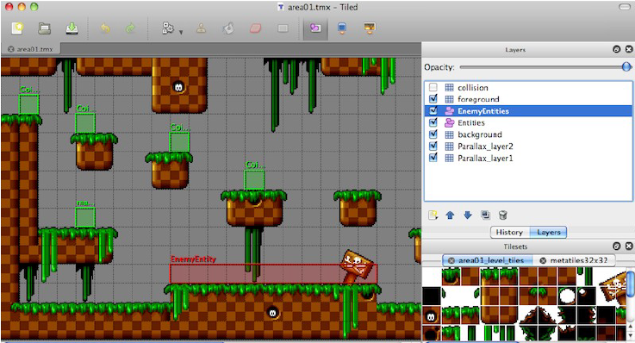
Basic concepts (VII)
Tile mapping: technique that consists in dividing the land or map of the game in equal squares, called tiles. Every one of these boxes can have a different graphic, and by joining them all you get the map. There are many programs that allow you to create tile maps, one of the most known is Tiled, free and open source.
Notes:
‹#›

Slide 24
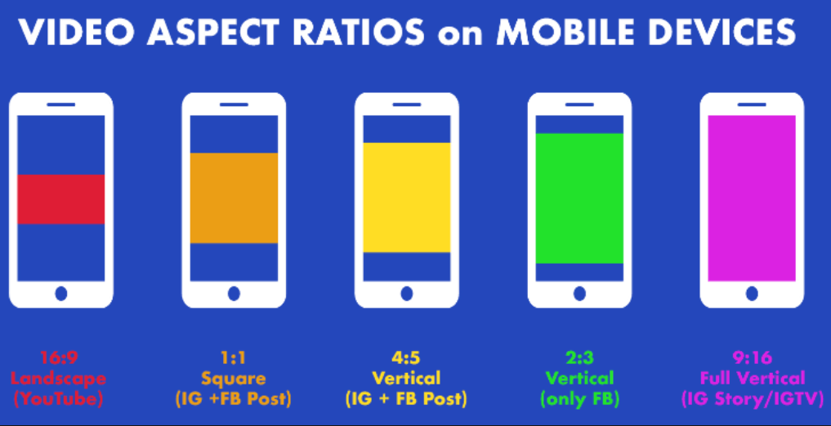
The aspect ratio
The aspect ratio is one of the most important aspects of the final device that we must consider when we develop games.
Even in the case of the same platform, the aspect ratio can be very different in different devices.
We can consult in execution the aspect ratio checking the value of the Screen.width and Screen.height (its quotient is the aspect ratio).
Depending on this, certain decisions can be made:
Adjust background images
The interface elements must always be positioned in relative positions to the size of the screen and never absolutely.
Clear graphics implies 'perfect pixel' sizes, therefore we must consider the different possible resolutions of the assets.
Notes:
‹#›

Slide 25
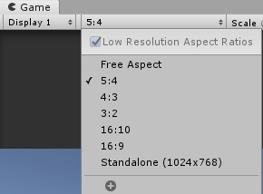
The aspect ratio
We can change the relationship of appearance in the game view allowing us to check your adaptation to different configurations
The listing of aspect ratios varies depending on the platform destination that we have configured in Build Settings, but we can add in any case new relationships of appearance.
It is good practice to try all of them.
Notes:
‹#›

Slide 26
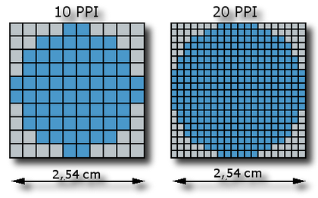
Other screen considerations
When we are designing elements of interface, it could be interesting to consult Screen.dpi (dots per inch, per centimeter if we divide by 2.54).
This parameter allows us to obtain the real size in centimeters of a pixel, in this way we can create, for example, buttons in a mobile device greater than the size of our finger
Notes:
‹#›

Slide 27
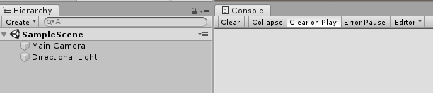
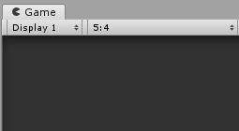
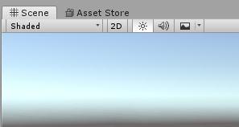
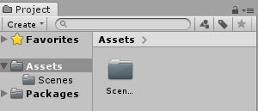
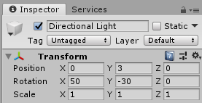
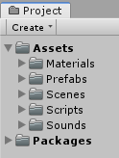
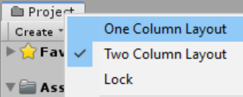
The views in Unity
The main views of Unity
Hierarchy
Scene
Game
Inspector
Project
Console
Notes:
‹#›

Slide 28
Basics in Unity
GameObject. the most important element of Unity.
Cameras, 2D and 3D objects.
Particle Systems.
Elements of interface, etc.
Scenes:
Will help us to divide our game into levels, screens of interaction, etc.
The GameObjects will be located in a scene.
Components
The nuts & bolts of objects and behaviours in a game. They are the functional pieces of every GameObject
One of the most important component that we can associate with a GameObject is a Script.
Assets
Resources of all kinds (3D geometries, textures, sounds, etc.) together with other elements of their own, created in Unity (scenes, prefabs, shaders...)
GameObjects will be created from Assets
An asset is the representation of any item that can be used in your game or project.
An asset may come from a file created outside of Unity, such as a 3D model, an audio file, an image, or any of the other types of file that Unity supports.
Notes:
‹#›

Slide 29
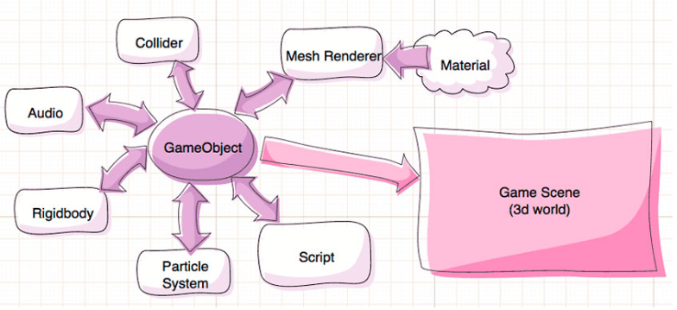
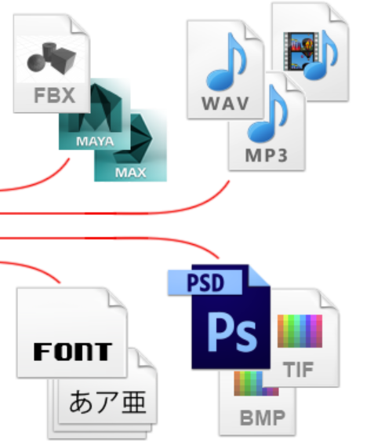
Basics in Unity
Assets
Components
GameObjects
Scenes
Notes:
‹#›

Slide 30
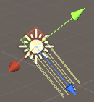
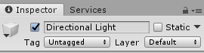
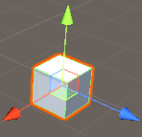
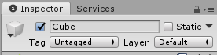

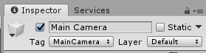
Special Game Objects
Cube, sphere, capsule, cylinder, plane and quad: simple objects created by Unity for simple forms.
Lights: (directional, point, spotlight and area).
Cameras: we can add several cameras that we can activate / deactivate or maintain simultaneously (by layers or rendering in different areas of the screen).
Others:
Interface elements (GUI), cloth, ragdolls, trees, etc.
Notes:
‹#›

Slide 31
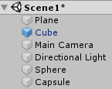
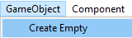
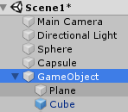
Special GameObjects
Empty game object only contains its Transform component. Usually created as a container for others game objects to keep the same properties.
Also interesting when we want to apply a script to different objects grouped by an empty game object.
The container
Notes:
‹#›

Slide 32
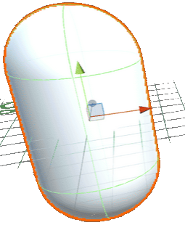
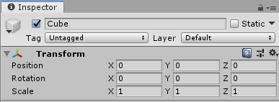
Main components
Transform: Always present in a GameObject. Stores the position, rotation and scale of the object.
Mesh Filter: Stores the polygon mesh of the GameObject.
Mesh Renderer: Responsible for defining how the mesh of the object is going to be rendered in the position defined by Transform.
Collider: Geometry , usually simpler than real geometry of the object, used by the GameObject to detect collisions with other objects.
Rigidbody: Necessary when we want our object to be submitted to the physical engine: gravity and other forces.
Sound: Through AudioSource (sound sources) and Audiolistener (where is the microphone in the scene).
Script: A little program to control the behavior of the GameObject.
Many more: particle systems, animations, etc.
Notes:
‹#›

Slide 33
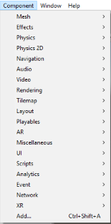
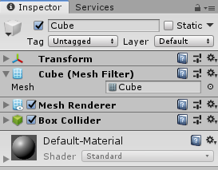
About components
On any GameObject that is in the scene, we can perform the following operations with components:
Activate / Deactivate components.
Remove components
Edit the properties of the component in the view Inspector.
In addition, we can also access through scripts to these components, add them, modify or check its parameters, etc. all by code
GameObject
Components
Notes:
‹#›

Slide 34
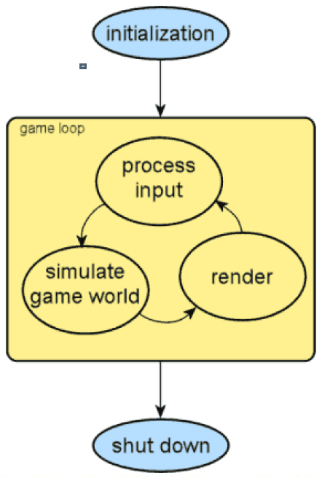
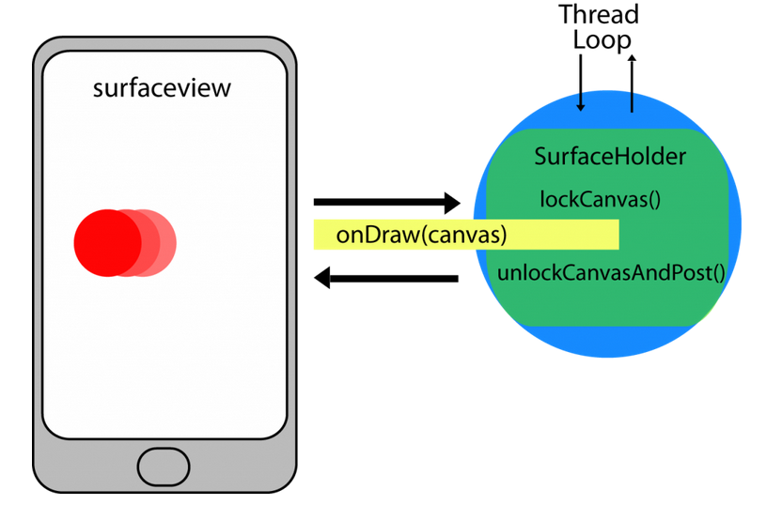
Structure of a videogame
Android SurfaceView
Notes:
‹#›

Slide 35
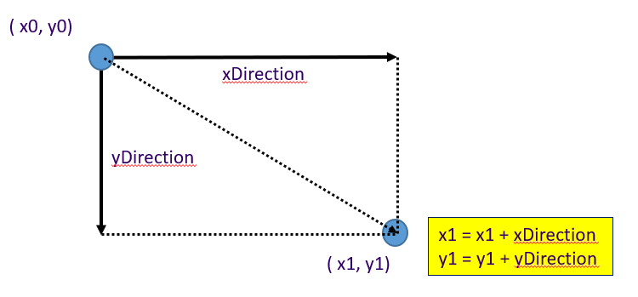
Structure of a videogame
Simulating movement
Android SurfaceView
public void run() {
while (!stop) {
// The movement of the ball
x += xDirection; y += yDirection;
Canvas c = null;
try { c = surfaceHolder.lockCanvas(null);
synchronized (surfaceHolder) { newDraw (c); }
} finally { if (c != null) surfaceHolder.unlockCanvasAndPost(c); }
} // while
} // run()
A ‘problem’: Depending on the speed of the device the ball with move more or less fast.
Notes:
‹#›

Slide 36
Structure of a videogame
A ‘solution’: Using delta time:
To make the animation to be independent of the FPS
So our characters will take the same amount of real-world time to move across the screen regardless of the rate of update.
Android SurfaceView
Long currentFrame, lastFrame;
double delta = 0;
lastFrame = System.nanoTime();
public void run() {
while (!stop) {
currentFrame = System.nanoTime();
delta = (currentFrame – lastFrame) / 1000000000;
// The movement of the ball
x += xDirection * delta; y += yDirection * delta;
lastFrame = currentFrame;
Canvas c = null;
try { c = surfaceHolder.lockCanvas(null);
synchronized (surfaceHolder) { newDraw (c); }
} finally { if (c != null) surfaceHolder.unlockCanvasAndPost(c); }
} // while
} // run()
Notes:
‹#›

Slide 37
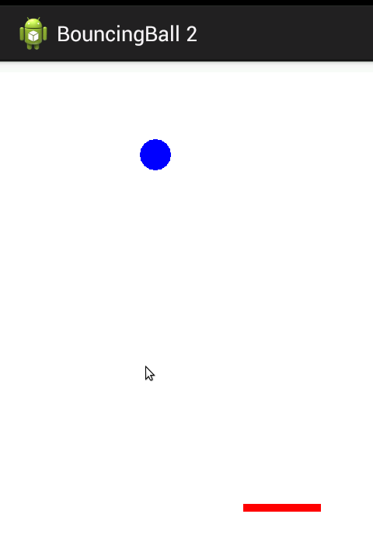
Physics in SurfaceView
public void motion () {
// A little physics engine
if ((x > width) || (x < 0) ) xDirection = -xDirection;
if ((y > height) || (y < 0) ) yDirection = -yDirection;
if (y + radius > yPaleta ) { // Controlling the palette
if ((x + radius > xPaleta) && (x - radius < xPaleta + ample)) {
yDirection = -yDirection;
}
}
// New movement
x += xDirection; y += yDirection;
invalidate(); // Call to onDraw to repaint the canvas
}
xPaleta + ample
xPaleta
x
y
radius
yPaleta
y + radius
yPaleta + alt
Y axis
Notes:
‹#›

Slide 38
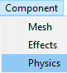
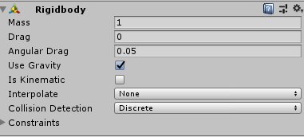
Physics in Unity (I): Rigidbody
Unity has a very powerful physics engine (PhysX of NVDIA).
To put an object under the control of physics, we have to add the Rigidbody component, so it will be subjected to the force of gravity and the collision of objects.
We will use Rigidbody for things that the player can push or move using forces (through scripting).
When an object has the Rigidbody component (and non-cinematic), you should not change your Transform component. If we want to change its position, we must do it applying forces or torsions to the object.
We can add joints with other objects to create more complex behaviors.
Notes:
‹#›

Slide 39
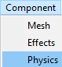
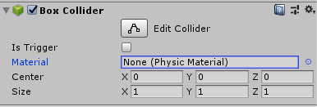
Physics in Unity (II): IsKinematic
The Rigidbody marked as kinematics (Is Kinematic) are not subject to physical laws and therefore are not affected by the forces. They are used in special circumstances, for example if we want to detect collisions but we want to manage them directly from scripting or objects that we want to move without apply forces.
When we want to detect collisions between two objects, we need that both have the Collider component, but for that collision be detected, at least one of the two objects must have a Rigidbody, only with Collider would not be detected, hence the utility of isKinematic.
We can add to an object only the Collider component, without Rigidbody. This is useful for static elements such as walls, with which objects can collide and bounce. As already we have commented, the objects that interact with it must have a Rigidbody so that the collision is detected.
Notes:
‹#›

Slide 40
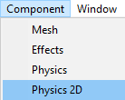
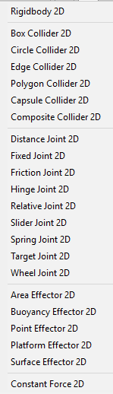
2D physics in Unity
Unity has a built-in second physical engine for 2D games: Box2D.
The presence of this 2D physical engine makes everything that we see in 3D has its 2D version.
In this way, all the components and elements that we are going to study have their version with the suffix 2d: like Rigidbody2d, Collider2d, Collision2d, OnCollisionEnter2d, etc.
We can NOT combine 2D physics with 3D. We're going to have to choose one of them.
The specific 2D components can be find in Component → Physics 2D
Notes:
‹#›

Slide 41
The RigidBody component
There are many properties that we can control of a Rigidbody, being the most important:
The Mass. The weight of the object or in Kg.
Friction (Drag). How much resistance we have from the air when we move by forces.
Angular friction (Angular Drag). How much resistance we have from the air when moving by forces of Torque.
Use Gravity. Whether or not the object is under the effect of gravity.
We can change the default severity from Edit → Project Settings → Physics
Is Kinematic. Whether the Rigidbody is cinematic or not.
We can create physical materials (Physic Material) to adjust the friction and the effect of bounce between colliding objects (Assets → Create → Physics Material).
They are applied on the Collider component of the object.
Dynamic Friction: The friction used when in motion. Usually a value from 0 to 1. A value of zero behaves like ice, a value of 1 will cause it to slow down quickly unless it is that a lot of force or gravity is applied to the object.
Static Friction: The friction used when an object is still on the surface. Usually a value from 0 to 1. A value of zero feels like ice, a value of 1 will make it difficult for the object move.
Bounciness: The amount of bounce (rubber effect). A value of 0 will not cause it to bounce. A value of 1 will make it bounce without losing energy.
Notes:
‹#›

Slide 42
The ForceMode and Rigidbody.AddForce method
The ForceMode
Use ForceMode to specify how to apply a force using Rigidbody.AddForce.
The AddForce function impacts how your GameObject moves by allowing you to define your own force vector, as well as choosing how to apply this force to the GameObject (this GameObject must have a Rigidbody component attached).
ForceMode allows you to choose from four different ways to affect the GameObject using this Force:
Acceleration, Force, Impulse, and VelocityChange
The Rigidbody.AddForce method
Rigidbody.AddForce method
Adds a force to the Rigidbody.
Force is applied continuously along the direction of the force vector. Specifying the ForceMode mode allows the type of force to be changed to an Acceleration, Impulse or Velocity Change.
Force can be applied only to an active Rigidbody.
If a GameObject is inactive, AddForce has no effect.
Notes:
‹#›

Slide 43



The Prefabs
A Prefab is a template that encapsulates a GameObject.
When we have created a GameObject it will be quite common to create a Prefab from it, especially when we need several Instances of this GameObject and / or its dynamic creation / destruction.
To create a Prefab, simply drag our GameObject over the project view, becoming another Asset.
It's a good practice to previously create a specific directory for Prefabs
The original GameObject
The Prefab
Notes:
‹#›

Slide 44


The Prefabs
From that moment we can instantiate as many GameObject as we want from the Prefab just by dragging on the hierarchy view or scene. If we modify the properties of the Prefab, they will be modified automatically all the instances.
The Prefab instances appear in a different color (blue) than the GameObject.
They will be very useful when we must instantiate objects during the game by scripting (for example the bullets when firing).
The Prefab
Instances of the GameObject
Notes:
‹#›

Slide 45
Programming with Unity
Unity is a component based engine meaning that components have to do some specific work independently.
This can be well combined with event driven programming methodology which mean that application ( or each of it's components ) are dependant on some event input.
Unity introduced really well designed Event (or Messaging ) system
Notes:
‹#›

Slide 46



C# and Unity
Unit allows the use of 2 programming languages to develop scripts:
C#
Javascript
Within the community of Unity C# is the most used for its power and qualities.
It is not necessary to master C# to be able to follow the scripts if you have previous knowledge of Java or C++ since they have a similar syntax.
Of course if you want to develop professional games, it is essential to fully master the language.
It's a good practice to previously create a specific directory for scripts
Creating and Using Scripts
C#
Notes:
‹#›

Slide 47

Template of a script
In UnityEngine we have the MonoBehaviour class, basic to define scripts that will be associated to GameObjects or Prefabs.
System.Collections belongs to .NET and allows to define lists, arrays dynamic, hash tables, etc.
System.Collections.Generic also belongs to .NET and allows to work with types of generic data.
using System.Collections; using System.Collections.Generic; using UnityEngine;
public class NewBehaviourScript: MonoBehaviour { // Start is called before the first frame update void Start() { } // Update is called once per frame void Update() { } }
Notes:
‹#›

Slide 48
Developing scripts in C#
In the programming of games in Unity not all C# characteristics are suitable for several reasons:
Performance problems
Problems with editor integration
Particularities deriving from MonoBehaviour
Features not fully implemented in Unity …
However, most of them are available.
You have to be careful with what is running in methods like Update(), FixedUpdate(), LateUpdate()... because they are executed repeatedly and very often.
Notes:
‹#›

Slide 49
Developing scripts in C#: Methods
To be able to associate a script to a GameObject, the script must derive from the MonoBehaviour class.
IMPORTANT: a script is a component of a GameObject, therefore, this refers to the script and not to the GameObject.
We can assign as much scripts as we want to a GameObject.
Most outstanding methods:
Awake(), Start()
Update(), FixedUpdate(), LateUpdate()
OnCollisionEnter(), OnCollisionStay(), OnCollisionExit() and their equivalents
OnTrigger().
OnBecameVisible(), OnBecameInvisible()
OnMouseDown(), OnMouseOver()
OnEnable(), OnDisable() ...
public class NewBehaviourScript: MonoBehaviour {}
Notes:
‹#›

Slide 50
Developing scripts in C#: Methods
Awake()
The Awake () method is the first method that is executed when the object is initialized.
void Awake () { ... }
It must be used as a substitute for the constructor.
It always runs before any Start() of all objects. First sill be executed all the Awake() of all the objects and then will be executed all the Start().
This will allow an initialization in 2 steps.
Start()
The Start() method is a second step in initialization, after all the Awake(), and all the Start() will be executed before any Update().
void Start () { ... }
Start() is only called if the GameObject is activated ('clicked' appears in the inspector).
With Awake() and Start() we can initialize in 2 steps, so that the objects that depend in its initialization of the position of others, could be created in the Start() method.
Notes:
‹#›

Slide 51
Developing scripts in C#: Methods
Update()
One of the main objectives of a script is to update the position, scale, rotation, forces, colors, states, etc. of the GameObject to which is assigned
To carry out these tasks Unity provides us with Update(), FixedUpdate() and LateUpdate().
void Update () { ... }
Update () is called in each frame.
The good performance of the code in this method (of all the objects in the scene) will be the one that will most influence the final FPS. Perfect for updating non-physical objects and receiving interactions of the users.
It will only be executed if the object is activated.
FixedUpdate()
FixedUpdate () will be called at regular intervals (the ratio can be changed in the preferences).
void FixedUpdate () { ... }
Unity performs physical updates after the FixedUpdate(). So, it is the perfect place for everything related to changes in the Rigidbody’s GameObject, for example to apply forces.
Notes:
‹#›

Slide 52

Developing scripts in C#: Methods
LateUpdate()
The LateUpdate () of a GameObject will be invoked after all the Update() of all the objects.
void LateUpdate () { ... }
So it is a new opportunity to update positions of objects when all the objects in the scene have already been updated using their Update() method.
It runs in each frame just like Update ().
Usually used when one object in the scene follows another. In this way we have the assurance that the first one has moved and the one that follows is updated after the movement of the first.
Notes:
‹#›

Slide 53

C# and Unity
MonoBehaviour methods and lifecycle
Notes:
‹#›

Slide 54
Developing scripts in C#: Variables
Variables (attributes in the OOP):
Private variables:
Can only be accessed within the class they are declared in.
Public variables:
A separate variable for each instance of the class.
Visible and accessible from outside of the class:
Accessible from the Inspector.
Accessible from other scripts
Static variables
The same variable is shared by all instances of the class
Can be private, protected or public.
public class StoneManager : MonoBehaviour {
private Vector3 offset;
private bool following = false;
private int jumpValue = 3;
// Other attributes and methods
}
Private variables
Notes:
‹#›

Slide 55




Developing scripts in C#: Public variables
Inspector
Game object
public class startStop : MonoBehaviour {
// Public variables
public int jumpValue = 2;
public Text missatge;
public float forceValue = 1;
// Other attributes and methods
}
Script
Public variables
Notes:
‹#›

Slide 56
Developing scripts in C#: Static variables
Managing public static variables
public class Enemy {
//Static variables are shared across all instances of a class.
public static int enemyCount = 0;
public Enemy() {
//Increment the static variable to know how many
//objects of this class have been created.
enemyCount++;
}
}
Accessing public static variables values directly.
public class Game {
void Start () {
Enemy enemy1 = new Enemy(); Enemy enemy2 = new Enemy();
//You can access a static variable by using the class name and the dot operator.
int x = Enemy.enemyCount;
}
}
Notes:
‹#›

Slide 57
Developing scripts in C#: Static variables
Managing private static variables, using methods.
public static class ControlCollisions {
private static int numCollisions = 0;
public static void incNumCollision () {
numCollisions++;
}
public static int getNumCollision () {
return numCollisions;
}
}
Accessing private static variables values calling methods.
public class RedStoneController : MonoBehaviour {
void OnCollisionEnter(Collision other) {
if (other.gameObject.tag == "FPCTag") {
print("Xoc amb la bola roja!!!");
Destroy (gameObject);
ControlCollisions.incNumCollision();
}
}
}
Notes:
‹#›

Slide 58

Developing scripts in C#: Vector3
Representation of 3D vectors and points.
This structure is used throughout Unity to pass 3D positions and directions around:
Vector3 ( x component, y component, z component)
It also contains functions for doing common vector operations.
Static Properties
back Shorthand for writing Vector3(0, 0, -1).
down Shorthand for writing Vector3(0, -1, 0).
forward Shorthand for writing Vector3(0, 0, 1).
left Shorthand for writing Vector3(-1, 0, 0).
More info about Vector3 here
Notes:
‹#›

Slide 59




Developing scripts in C#:
Input.GetAxis and axisName
axisName: special values to link axes with special keyboard keys.
Examples: Horizontal, Vertical:
By default they are mapped to the arrow keys.
The value is in the range -1 to 1
Input.GetAxis: Returns the value of the virtual axis identified by axisName.
axisName
Keyboard key
More info about Input.GetAxis here
Notes:
‹#›

Slide 60
Developing scripts in C#: Transform
Using transform component
Some methods let us to change the position, rotation and scale of an object.
Translate:
Moves the transform in the direction and distance of translation. Exemple:
// Horizontal movement of an object using horitzontakl arrow keys
transform.Translate(Input.GetAxis("Horizontal"), 0, 0);
Rotate:
Applies a rotation around and axis.
// Rotate using vertical arrow keys
transform.Rotate(Input.GetAxis(“Vertical"), 0, 0);
Scale:
The scale of the transform relative to the parent.
// Scale using vertical arrow keys
transform.localScale += new Vector3(Input.GetAxis(“Vertical"),0,0);
Transform.forward:
Manipulate a GameObject’s position on the Z axis (blue axis) of the transform.
More info about transform here and here
Notes:
‹#›

Slide 61
Developing scripts in C#: Time.deltaTime
Time.deltaTime provides the time between the current and previous frame. So our event could depend only on time and NOT on the hardware frequency.
using System.Collections;
using System.Collections.Generic;
using UnityEngine;
public class Rotate : MonoBehaviour
{
// Start is called before the first frame update
void Start() { }
// Update is called once per frame
void Update() {
// Rotate one degree per second
transform.Rotate(Time.deltaTime, 0, 0);
}
}
Notes:
‹#›

Slide 62


Developing scripts in C#: Adding text to the scenes
A child of Canvas
Notes:
‹#›

Slide 63


Developing scripts in C#: Adding text to the scenes
using System.Collections; using System.Collections.Generic;
using UnityEngine;
using UnityEngine.UI; // For the Texdt class
using System; // For the String class
public class Jump : MonoBehaviour {
public int jumpValue = 2; private Rigidbody rigidBody;
// The attribute to control the text
public Text missatge;
// Start is called before the first frame update
void Start() { }
void Update () { }
}
Notes:
‹#›

Slide 64
Developing scripts in C#: Collisions
Collision detection
When a GameObject has the Rigidbody component is under the physical motor control and if you have a Collider will react automatically to collisions.
There are times when we want to run something when collisions take place.
It will therefore be interesting to receive a notification when a collision occurs.
Methods related with collisions:
OnCollisionEnter() is invoked when produces the collision,
OnCollisionStay() while the collision is still active
OnCollisionExit() when the collision has stopped occurring.
One of the usual actions will be to find out what object has been collided. A good is the use of Tags for our objects
Tags are labels that we can create and assign to objects to group according to their type (enemies, walls, etc.).
In this way we can check if the Tag of the object with which collides is the one that interests us or not, to carry out the associated action.
Notes:
‹#›

Slide 65
Developing scripts in C#:
Accessing components
The simplest and most common case is where a script needs access to other Components attached to the same GameObject.
A Component is actually an instance of a class so the first step is to get a reference to the Component instance you want to work with. This is done with the GetComponent function. Typically, you want to assign the Component object to a variable, which is done in C# using the following syntax:
void Start () {
Rigidbody rb = GetComponent<Rigidbody>();
}
Once you have a reference to a Component instance, you can set the values of its properties much as you would in the Inspector:
void Start () {
Rigidbody rb = GetComponent<Rigidbody>();
// Change the mass of the object's Rigidbody.
rb.mass = 10f;
}
Notes:
‹#›

Slide 66
Developing scripts in C#: Collisions
Considerations about collisions
All objects that move by physical forces must have their Rigidbody.
Detecting collisions involves having a Collider.
The Collider can be of a different geometry than the visual one. Usually simpler to simplify calculations.
A Collider can be of the mesh type but to detect collisions between Colliders type mesh, the meshes must be Convex (convex meshes).
We can create Colliders as the sum of several simple Collider (not of mesh type), for this we will add children to the GameObject with Colliders.
If we want objects with Colliders but without being subjected to the physical engine, at least one must have Rigidbody marked as IsKinematic, so that it will be not affect by physics.
Notes:
‹#›

Slide 67
Developing scripts in C#: Collisions
public class Move : MonoBehaviour {
private Rigidbody rigidBody; // 1.- The private variable
// Use this for initialization
void Start () {
// 2.- Accessing to the RigidBody component of the object: Only on time!
rigidBody = GetComponent<Rigidbody>();
}
// Update is called once per frame
void Update() { }
private void FixedUpdate() {
// 3.- Using rigidBody every time. Pay attention to the mass of the object!
rigidBody.AddForce(
new Vector3(Input.GetAxis("Horizontal"),
0,
Input.GetAxis("Vertical")));
}
}
Notes:
‹#›

Slide 68
Developing scripts in C#: Triggers
Triggers
Sometimes it can be interesting to know when our character has entered into certain area or collided with some object but we do not want the physical engine produces a reaction to such a collision.
We can create a GameObject whose objective is contain a Collider marked as isTrigger, sometimes even without mesh or render, so that our character can enter into it, as if it were transparent, and we can take a certain action.
Objects marked as isTrigger fire in the other object events of type:
OnTriggerEnter()
OnTriggerStay()
OnTriggerExit().
They work in a similar way to the OnCollision.
Notes:
‹#›

Slide 69
Developing scripts in C#: Accessing components
Access to components through scripts
One of the most interesting features of the scripts is their ability to access to any of the components of the object and consult and / or modify its properties.
To access any component:
gameObject.GetComponent <Component> ()
where Component will be the class that defines the component we want to access.
Example:
void OnCollisionEnter(Collision other) {
GameObject other = other.gameObject;
if (other.tag == "Target") {
print ("Collision with object.");
Mesh m = other.GetComponent <MeshFilter>(). Mesh;
print ("Size:" + m.bounds.size);
}
}
Notes:
‹#›

Slide 70
Developing scripts in C#: Accessing components
Access to components through scripts
Example:
void OnCollisionEnter(Collision other) {
GameObject o = other.gameObject;
if (o.tag == "Target") {
o.GetComponent <MeshRenderer> (). material.color * = 1.2f;
}
}
In this example when colliding with an object we increase the color intensity by 20% and therefore the object becomes clearer.
Notes:
‹#›

Slide 71
Developing scripts in C#:
Communication between objects
Communication between objects
There are several ways to communicate between objects:
Explicitly, by means of a public variable in a script in the another object dragged into the editor.
Using transform.Find (name of the GameObject) that will search within its hierarchy.
Accessing all the children: foreach (Transform child in transform)
Using the static method GameObject.Find (name GameObject) that will search for active objects with that name. It is not very advisable, it is more efficient to search by Tag with GameObject.FindWithTag (tag).
Using SendMessage and BroadcastMessage.
Object searches must be performed in the methods Start() or Awake() keeping its value in variables.
They should never be done in the Update() methods.
Notes:
‹#›

Slide 72
Developing scripts in C#:
Communication between objects
SendMessage and BroadcastMessage
With SendMessage we can execute a method of any script associated to a GameObject.
With BroadcastMessage we can execute a method of any script associated to a GameObject and also in all children that can have this same method in your scripts.
Example:
public GameObject receiver;
...
void Update () {
...
receiver.SendMessage ("Die");
}
Execute the Die method of the GameObject associated with the receiver. In the case that the object has several associated scripts where there is the Die method, this will execute in each one of them.
Notes:
‹#›

Slide 73
Developing scripts in C#: Coroutines
Coroutines
Unity engine is not Thread Safe, this means that we can not do calls from a thread of execution different from the main one to the API of your engine.
Unity provides coroutines, a mechanism similar to threads.
The objective is to achieve an operation similar to the Update method but with whatever method we design.
Corutines can be started (StartCoroutine) and stopped (StopCoroutine).
Unity saves the list of active coroutines and executes them after the method LateUpdate of each object in the scene.
They must take a small action and return control immediately. When the coroutine is called again, the following instruction will be executed after assignment. The implementation is carried out using yield return.
They will return IEnumerator and each yield return will cede the control to Unity until that is invoked again in the next frame, continuing its execution after the last yield return.
Notes:
‹#›

Slide 74

Developing scripts in C#: Coroutines
Coroutines
They are useful in many tasks, for example:
To perform a sequence of actions, which one number must be executed one after, a number of frames or concrete time.
To carry out verifications every certain time or frames. We could do that checks within an Update, but perhaps it implies a check excessively frequent. With the coroutines we can do that this was carried out some time, winning so much efficiency in the process.
Notes:
‹#›

Slide 75

Developing scripts in C#: FP and TP games
Games First and Third Person
First and third person games (known as First Person, Third Person) are very common and it is interesting to be able to approach them in Unity.
Fortunately Unity, thanks to a set of resources (Standard Assets) available after installation, we greatly facilitates the development of these two types of games
The first person is the typical games where the camera is placed in the eyes of the character and at the most we see his hands or arms.
The third person allows us to see completely our character, the camera being normally behind of the character.
First Person
Third Person
Notes:
‹#›

Slide 76

Unity and the different platforms
One of the most remarkable features of Unity is the wide variety of platforms that it supports in the deploy of the applications.
Unity maintains the vast majority of its common characteristics independently of the platform.
But the following aspects require special considerations:
Game controls (joystick vs tactile, etc.)
Shaders and other features dependent on the rendering capabilities of the devices.
Aspect ratio and output resolution.
Notes:
‹#›

Slide 77



Build Settings
From the File → Build Settings we can specify the platform on which we want to deploy our application.
The Switch Platform option will carry out the conversion of current assets to the format that the target platform needs.
The Player Settings option will show in the inspector the general options and specific to the platform for manage them to our liking.
Notes:
‹#›

Slide 78

Player Settings
Depending on the platform selected, we will be allowed to select a set of our own options:
Resolution
Icons
Splash screens (only versions Plus and Pro).
Texture compression method.
And others of the platform destination.
Notes:
‹#›

Slide 79

Native plugins and development tools
Another feature of Unity is to allow native plugins, that is, third-party add-ons for an specific platform to carry out something very specific for it. For example: To manage the purchase of and app on Android or iOS.
In some cases (Android, iOS) Unity allows generate a project that can later be opened from the official development tools: Android Studio and Xcode.
Notes:
‹#›

Slide 80

The conditional compilation
When we are working on a project, in a game for different platforms, sometimes we need specific code for each platform. It leads us to the temptation to divide our project into different projects depending on the platform and this is a mistake.
To the extent possible, our project has to be unique, one way to solve this problem is the conditional compilation, that certain code is compiled for some platforms and not for others.
In this way we avoid fragmenting the project and both the maintenance of it is much more simple.
Platform Dependen Compilation
Notes:
‹#›

Slide 81

Unity in Desktop
In Mac, Windows and Linux environments, Unity allows you to deploy its maximum possibilities; allowing even the use of very specific features (DirectX 11, for example).
Keyboard and mouse can be managed in a very simple way:
Input.mousePosition, Input.GetMouseButton, Input.GetMouseButtonDown, Input.GetMouseButtonUp, etc.
Input.GetKey, Input.GetKeyDown, Input.GetKeyUp, Input.GetAxis
GetAxis ([“Vertical” | “Horitzontal” ]): Get information from arrow keys from the keyboard.
A handicap in Desktop is that you are usually given the option to the user to choose the final resolution. Using Screen.width and Screen.height we can know the resolution and make the corresponding adaptations.
Notes:
‹#›

Slide 82

Unity in consoles
Unity is able to deploy applications for the main consoles.
Special licenses are required whose costs. They can vary a lot (and even be free).
The first step is to become a certificated developer of the platform in question.
Microsoft, Sony and Nintendo offer environments of development for 'indies'.
Notes:
‹#›

Slide 83

Unity and mobile devices
The personal version of Unity allows the deployment of our application on mobile devices.
Mobile devices have interface capabilities very different from other platforms:
Lack of buttons suitable for games and the keyboard. It is not an element, either.
Instead, they provide accelerometers (orientation of the device), gyroscopes, magnetometer (compass), GPS and other sensors (light, proximity, etc.). These sensors can be enormously attractive in the development of games.
Most mobile devices allow the use of several 'touches’ (multi-touch) on the surface of the screen, which makes it possible to develop interfaces based on several fingers, gestures and actions very expressives
Unity will allow us to take advantage of these capabilities.
Notes:
‹#›

Slide 84

Unity and mobile devices
It can be quite heavy to have to compile our application and deploy it on the device every time we want to try things from the Unity editor.
To be able to have in the editor the possibility of receiving input events from a device mobile (sensors or touches on the screen) and be able to see the results in our game view of the editor, we can install the Unity Remote application on our device, connect this one to Unity and enjoy the device integration options on our editor; and all without having to compile and deploy each time on the device.
The first thing we should do is install the Unity Remote application on the device Android or iOS, in both systems the connection is carried out by USB cable.
In the case of Android devices we need the Android SDK installed and Java (JDK).
Depending on the operating system and the device, it may be necessary to install drivers adequate.
Unity Remote 5
Notes:
‹#›

Slide 85

Unity and mobile devices
Unity Remote works in a way that when we give to 'Run', all the actions that we carry out on the device will be sent to the editor, so that we can see the reaction in our game.
Inputs: touch input on the screen of the device, accelerometer, gyroscope, streams of the device camera, magnetometer and GPS.
To configure Unity Remote we must select the device that we want to use from the option Device of the Edit → Project Settings → Editor.
Once connected the device and taking in this the Unity Remote application running, when executing our game in the Unity editor we can see the game in action on the screen.
Any interaction that we carry out in the device will be forwarded to the editor of Unity, so we could control, through scripting, the running of our game on a mobile device.
Notes:
‹#›

Slide 86


Unity and Android
Building your Unity game to an Android device for testing
https://unity3d.com/es/learn/tutorials/topics/mobile-touch/building-your-unity-game-android-device-testing
Notes:
‹#›

Slide 87

Accelerometer on mobile devices
With the movement of the mobile device, its accelerometer reports linear acceleration changes to through its 3 primary axes in 3D space.
We can use this information to detect the orientation of the device and any change produced on this.
Another way to consult the orientation is to use Input.deviceOrientation to return an enumeration of type DeviceOrientation: FaceDown, FaceUp, LandscapeLeft, LandscapeRight, Portrait, PortraitUpsideDown, Unknown
Acceleration along an axis is returned in units G (1G = 9.81 m / s ^ 2)
A value of 1.0 represents a load of 1 severity on that axis
Accelerometers are aligned with the game view (Game View), so it is important look at the orientation that we define in 'Player Settings' (landscape, portrait etc.) at the time of know how the X, Y, Z are oriented
If we have selected 'portrait', holding the device in its original vertical position (with the screen towards the user), the X axis is positive to the right, the Y axis is positive directly upwards, and the Z axis is positive towards the user.
Notes:
‹#›

